Slide 1

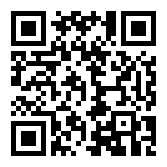
Bird Song ID

Slide 2
DEMO Presentation Bird song identification
Thanyaporn Phinthuphan
22 May 2019

Slide 3
Outline
introduction
methodology
results & discussion
deployment & demo

Slide 4
INTRODUCTION
motivation
previous studies
objective
benefits

Slide 5


Introduction Motivation

Slide 6
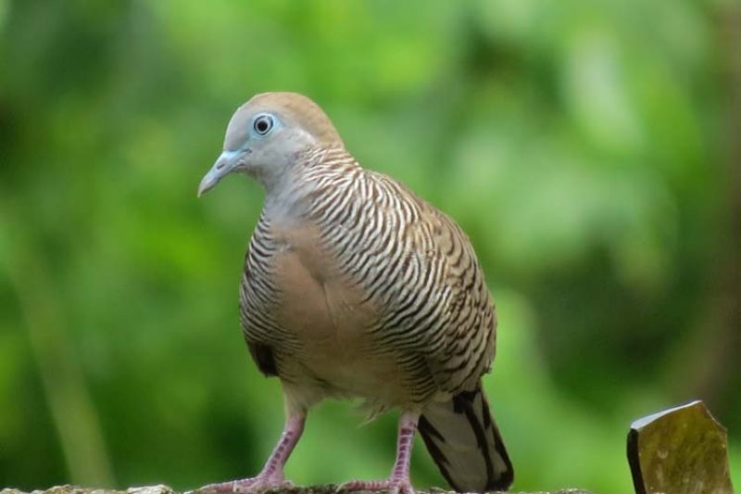
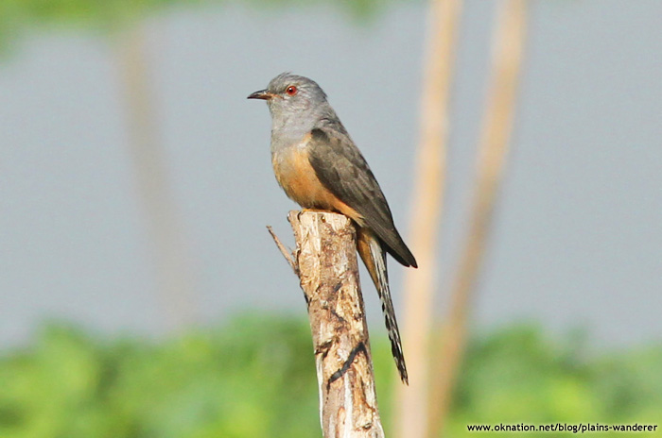
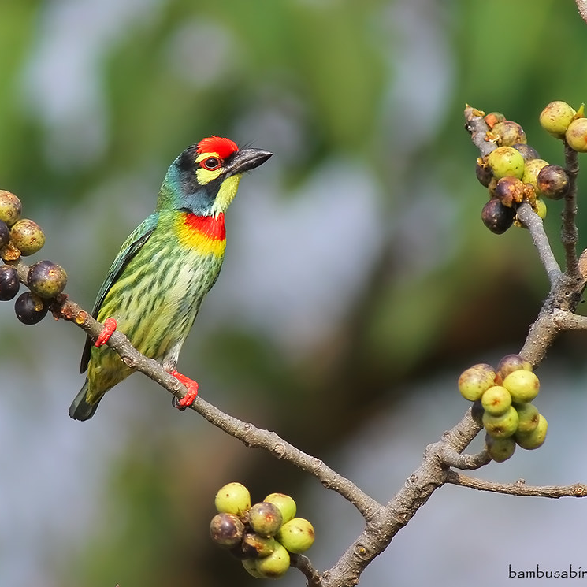
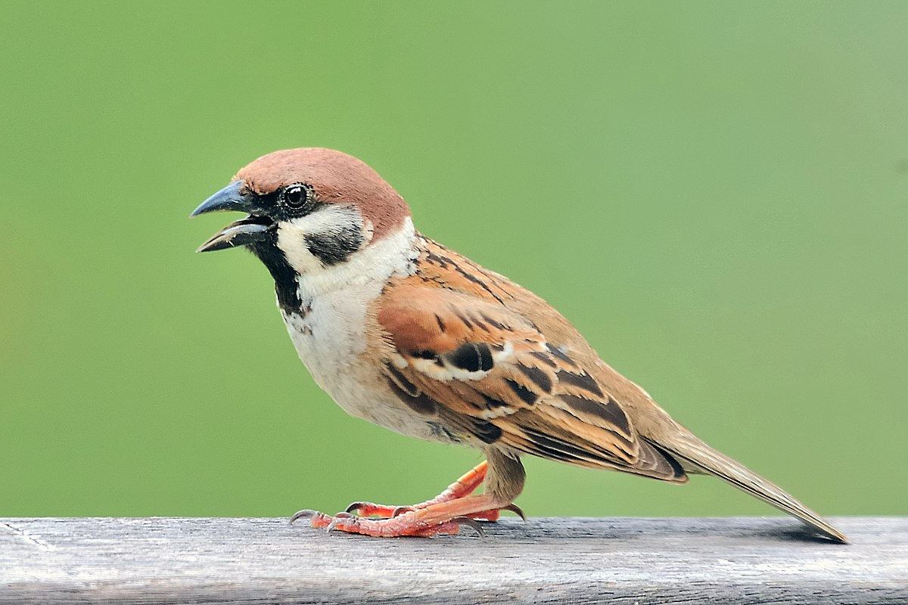
Introduction Motivation

Slide 7
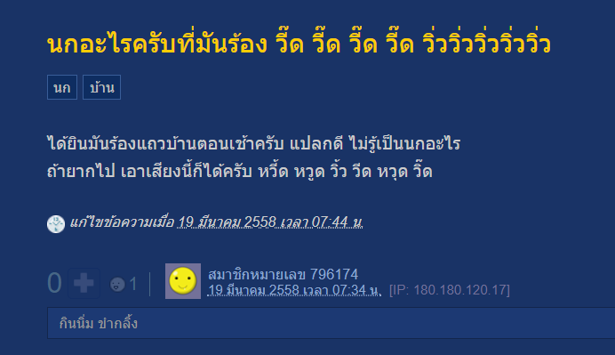
Introduction Motivation

Slide 8
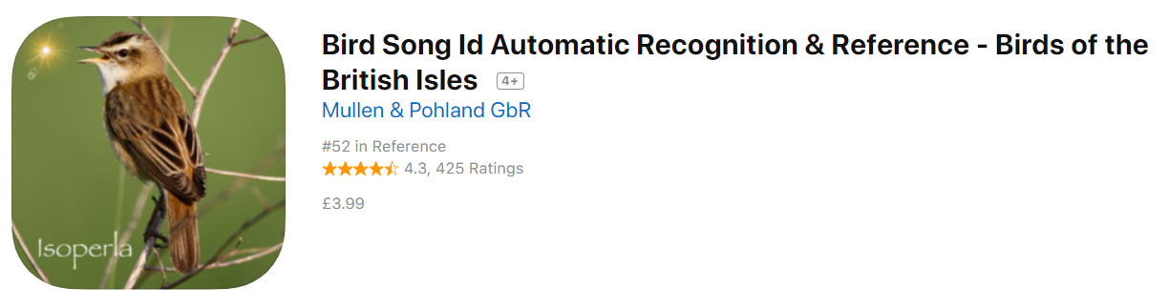
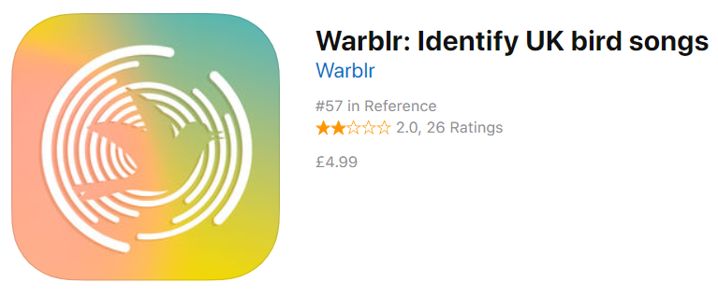

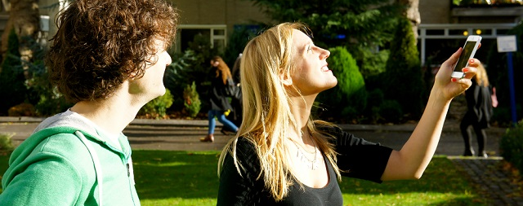
Introduction Previous studies
NIPS4B 2013 → France
ICML 2013 → France
MLSP 2013 → USA
BirdCLEF 2014-2019 → USA
What about Thai birds?

Slide 9
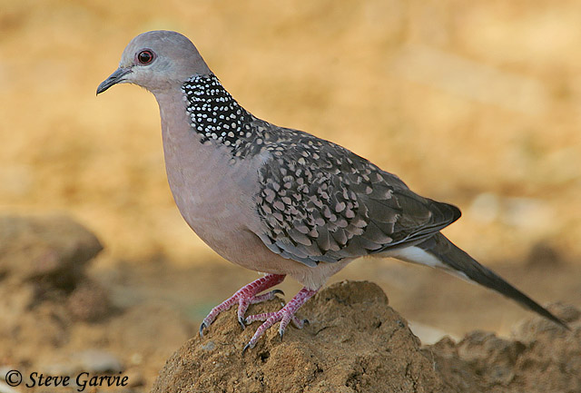
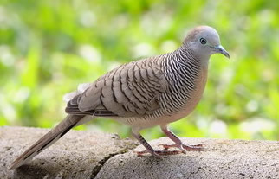
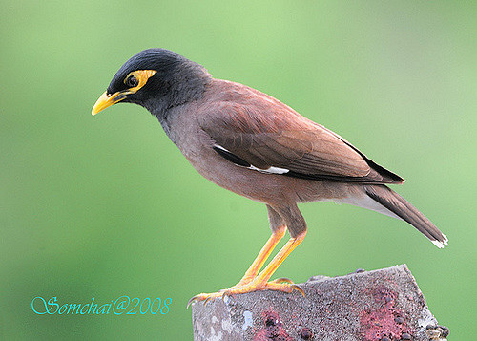
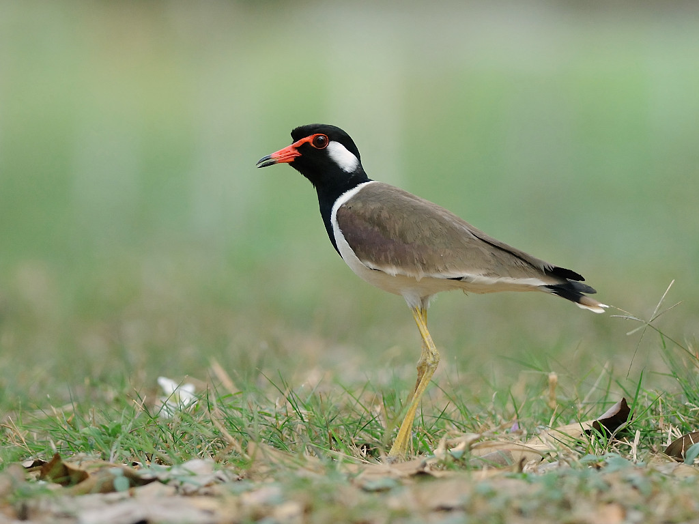
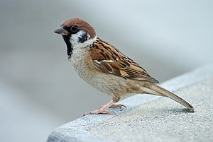
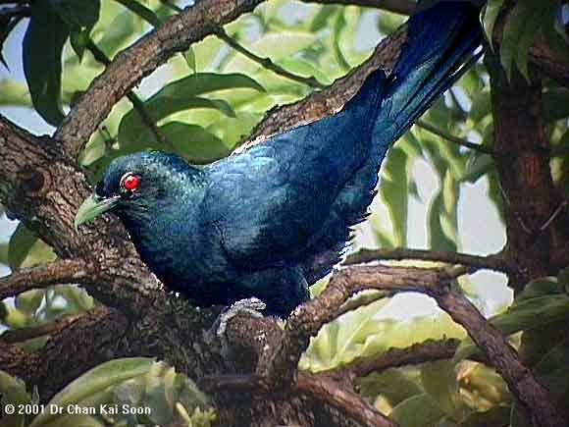
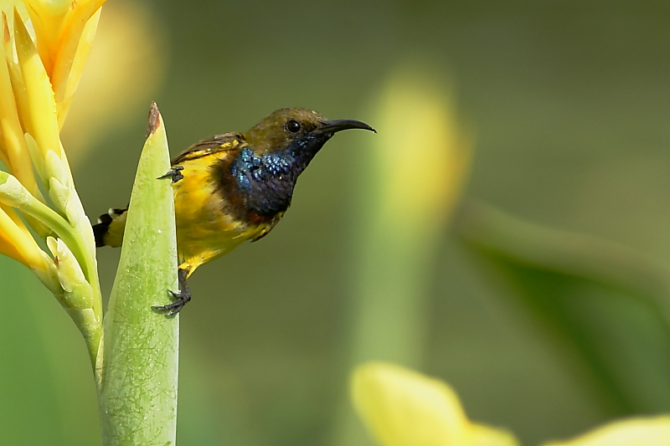
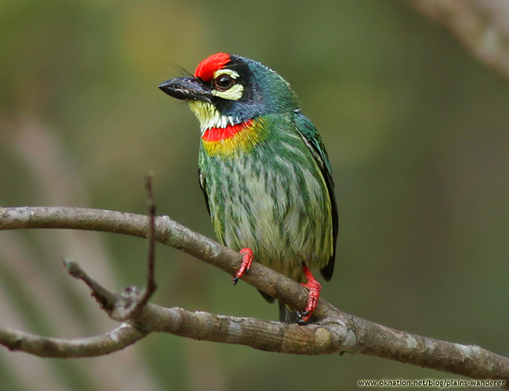
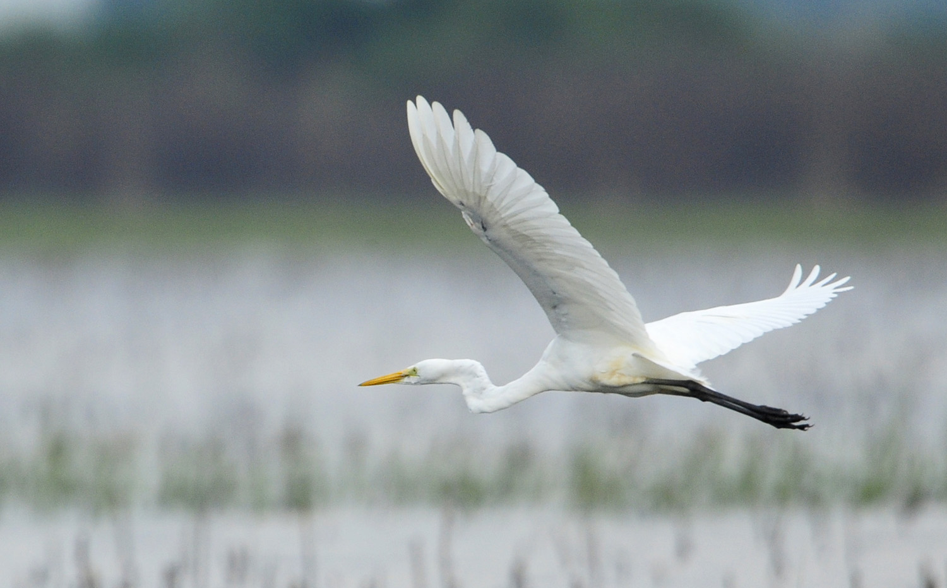
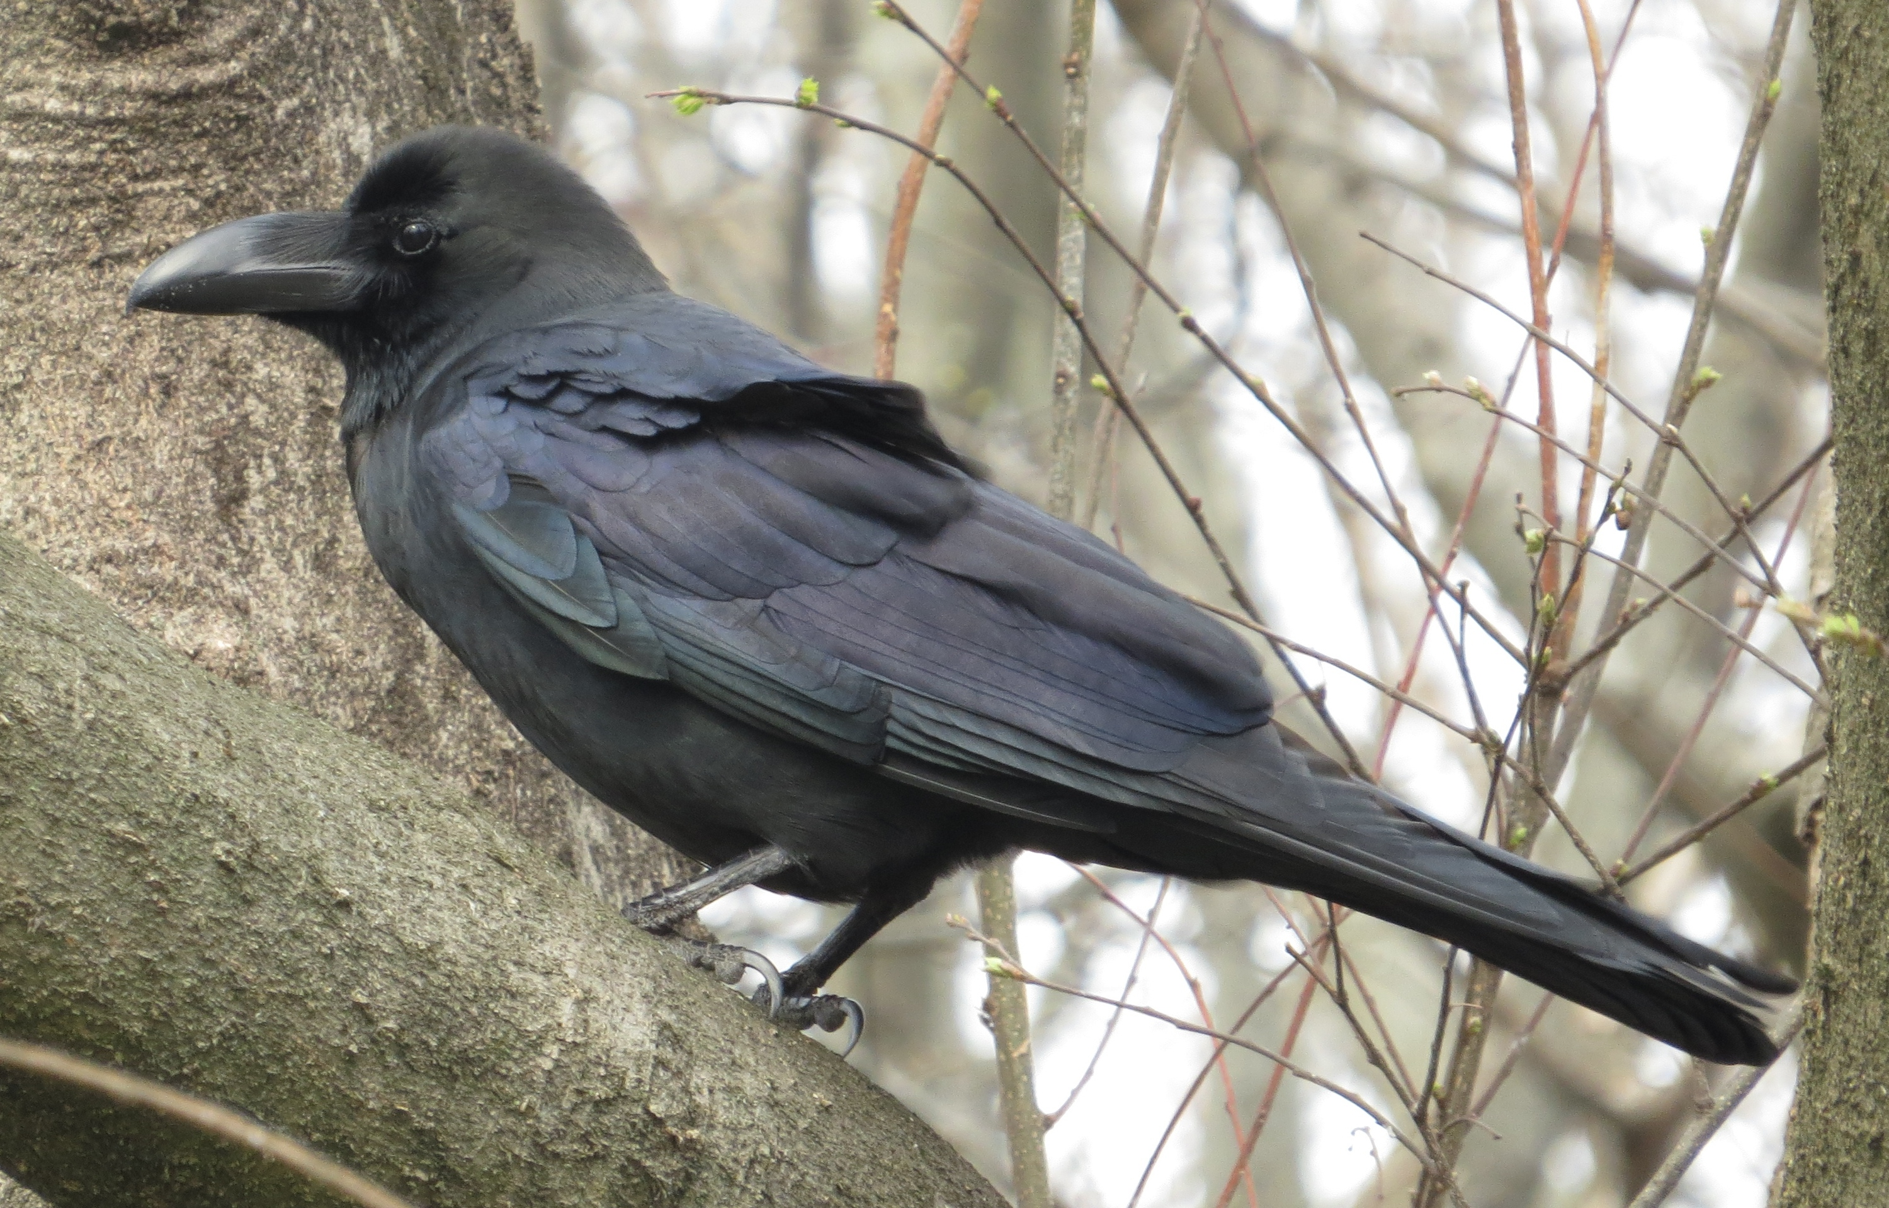
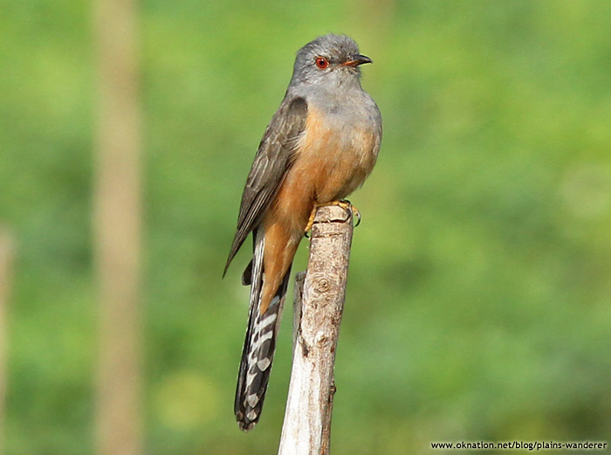
Introduction Objective
to develop the program for identifying bird species from their sounds
including only 40 common birds in Thailand

Slide 10
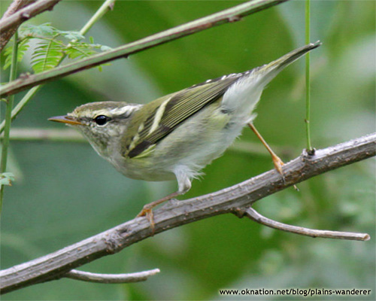
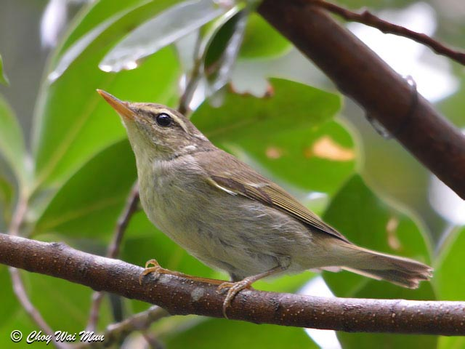
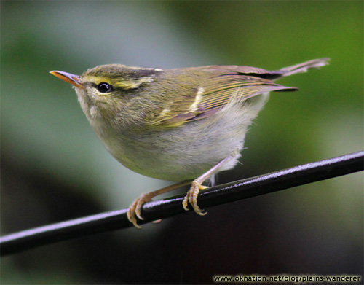
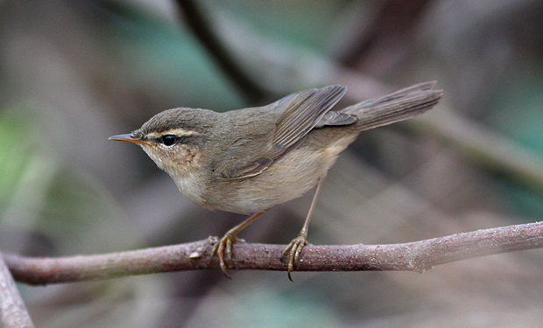
Introduction Benefits
bird learning
look-alike bird identification
population/migration monitoring

Slide 11
Methodology
dataset
references
feature generation
network architecture

Slide 12
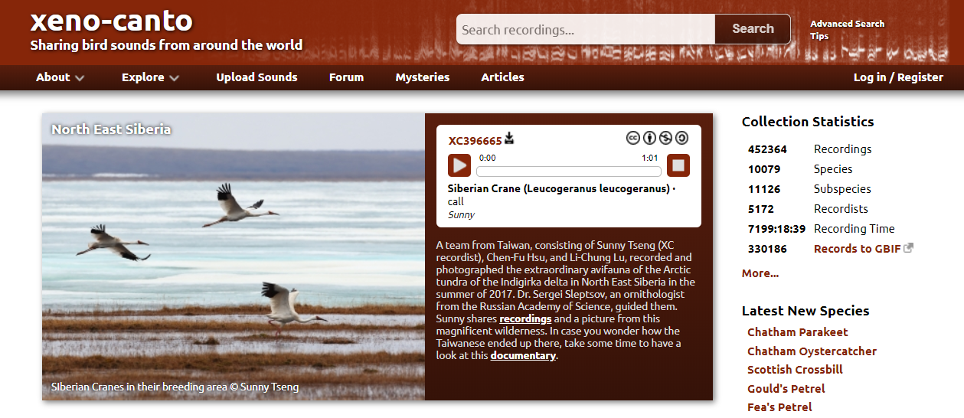
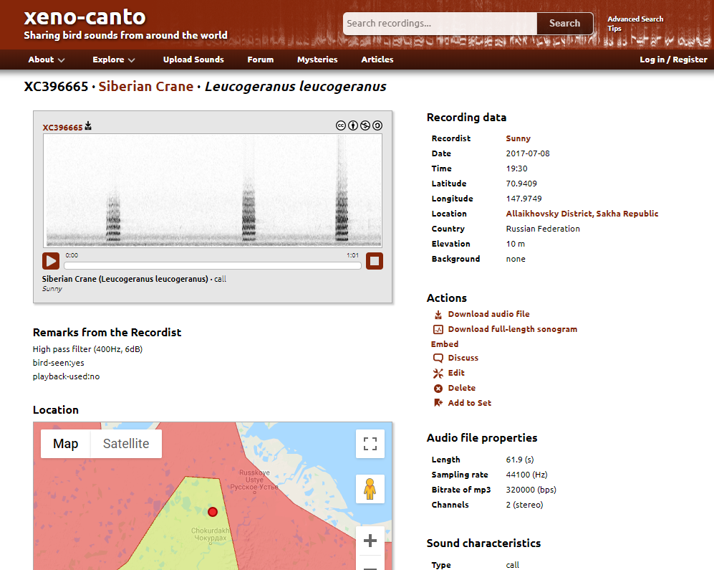
Methodology Dataset
bird song dataset - https://www.xeno-canto.org/

Slide 13
Methodology Dataset
query by science name as of March 2019
select only class that have more than 10 files
→ 80 class / 8,746 files
length 1 sec – 10 min
training data - quality A/B/C with not more than 100 files/class
→ 80 class / 5,507 files (63%)
sampling data → 11 class / 1,847 files

Slide 14
Methodology References
paper - winning solution for NIPS4B 2013; Mario Lasseck
- winning solution for BirdCLEF 2016; Elias Sprengel & teams
model - Multi-label classification with random forest
- Multi-class classification with CNN
- Multi-label classification with CNN

Slide 15
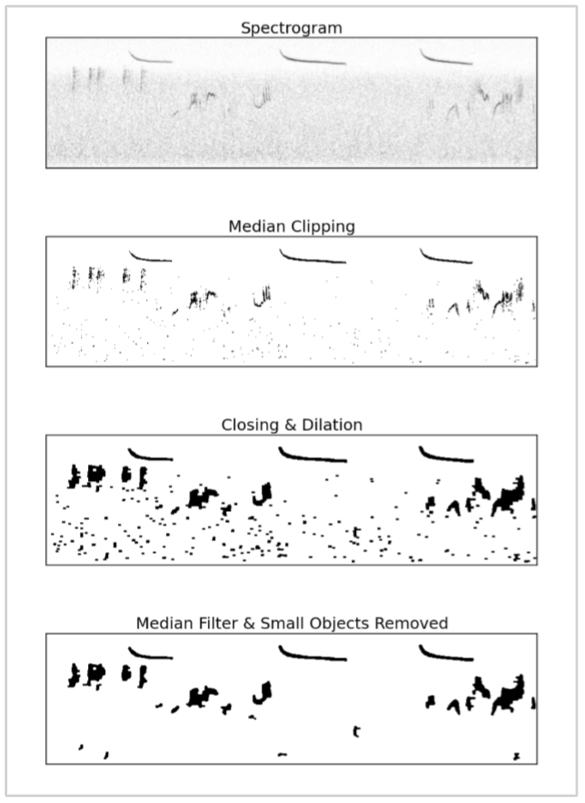
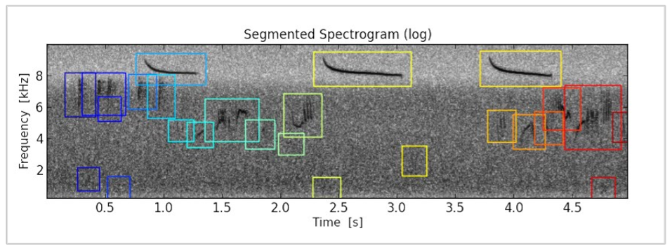
Methodology References
1 : Multi-label classification with random forest
referred from Lasseck (2013)
preprocess: wav → STFT → median clipping → segment
feature: segment correlation
classifier: 87 Random Forest

Slide 16
Methodology Feature generation
preprocessing
STFT using hanning window → normalized
reducing background noise with median clipping
closing & dilation → segmentation (size/position)

Slide 17
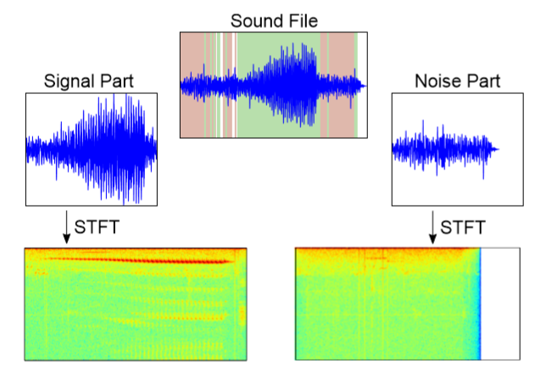
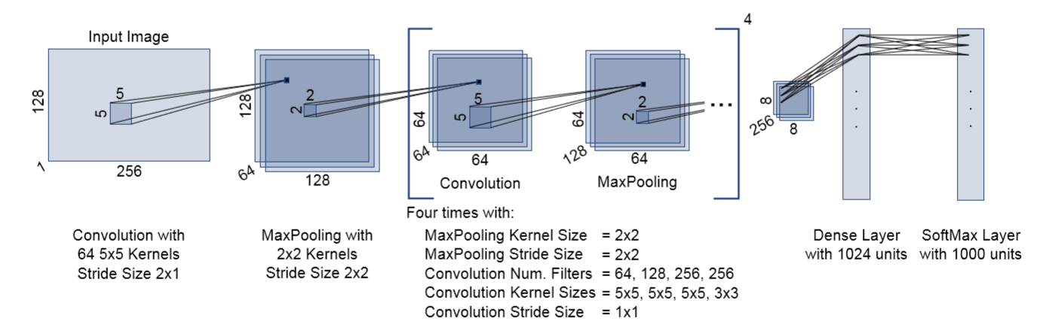
Methodology References
2 : Multi-class classification with CNN
referred from Sprengel et al. (2016)
preprocess: wav → STFT → median clipping
signal/noise separation
dividing the spectrograms into chunks
classifier: 5 CNN + 1 dense + soft-max

Slide 18
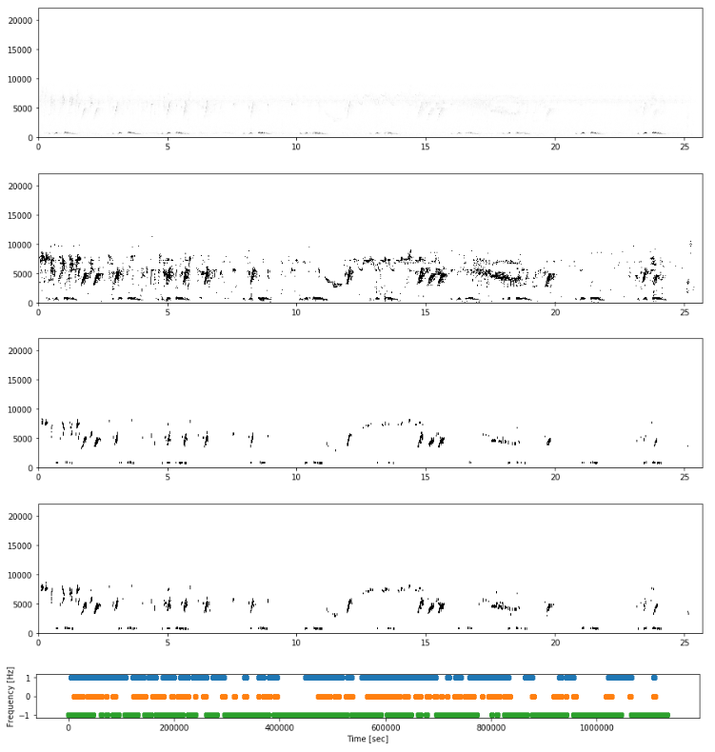
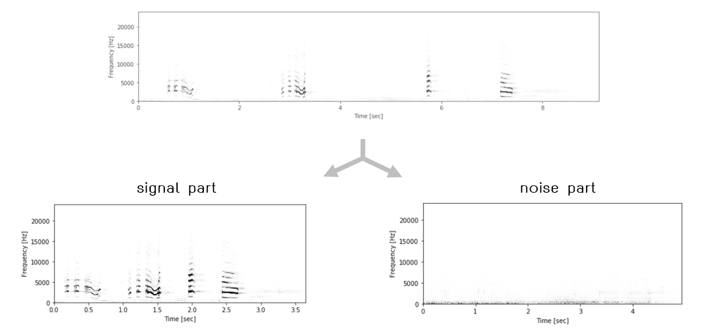
Methodology Feature generation
signal / noise separation
STFT → normalize → smooth → median clipping
mask vector for separate audio files

Slide 19
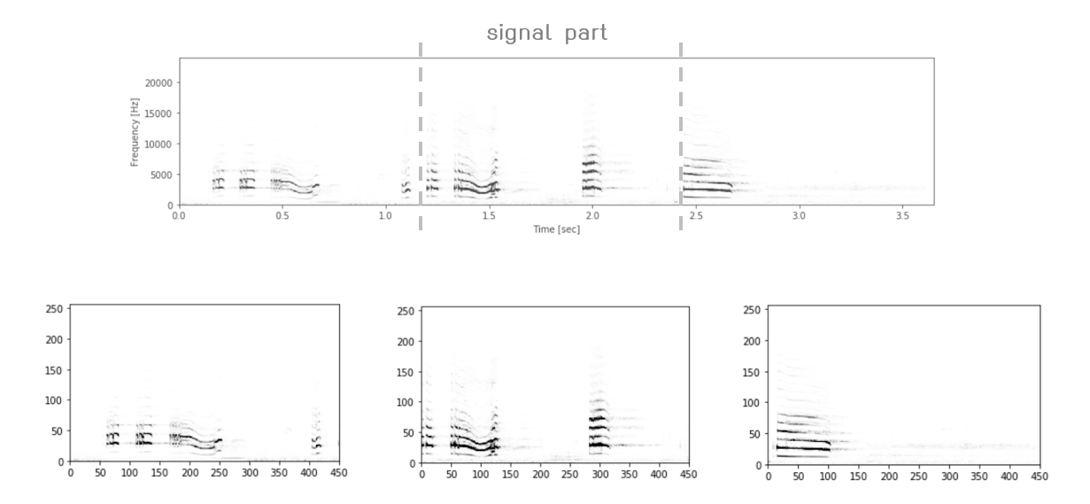
Methodology Feature generation
dividing the spectrograms into chunks
fixed size input of 512 pixel (~3 sec)
each chunk is unique sample (because separated signal / noise)
multiple prediction per file
→ average to final result

Slide 20
Methodology Network architecture
5 CNN and 1 dense with max pooling and ReLU activation function
soft-max layer → multi-class classification
batches of 8 examples
train : test = 90 : 10

Slide 21
Methodology References
3 : Multi-label classification with CNN
improved from model 1 and 2
preprocess: wav → STFT → median clipping
signal/noise separation
dividing the spectrograms into chunks
classifier: 5 CNN + 1 dense + sigmoid layer
Sigmoid Layer
with 80 units

Slide 22
Methodology Network architecture
sigmoid layer → multi-label classification
loss function → binary cross entropy
Sigmoid Layer
with 80 units

Slide 23
Mario Lasseck
winning solution
NIPS4B 2013
Elias Sprengel et al.
winning solution
BirdCLEF 2016
Multi-label classification with CNN

Slide 25
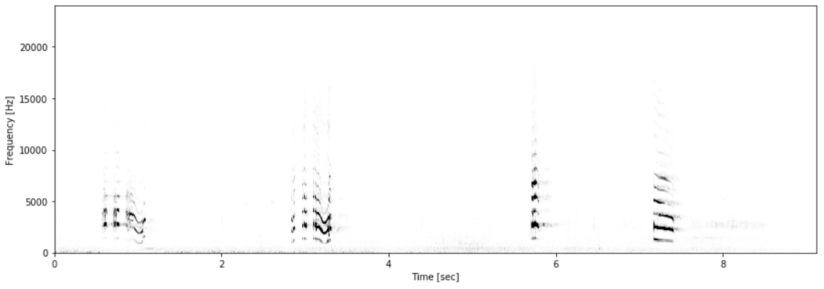

Slide 26
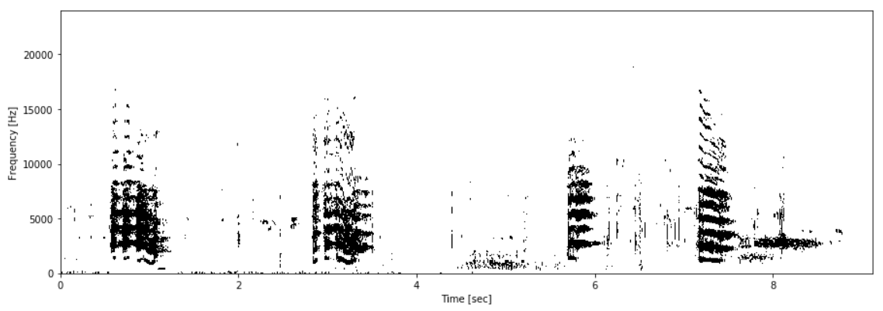

Slide 27
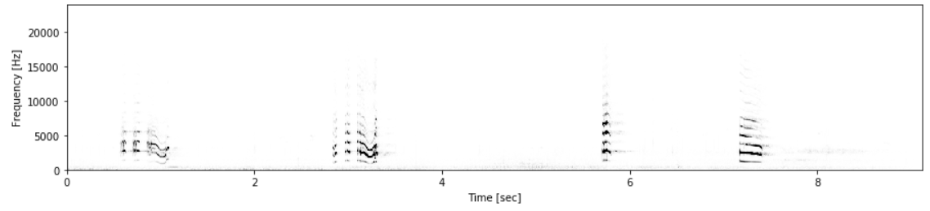
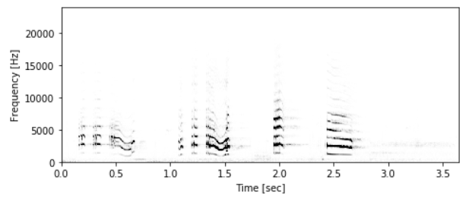
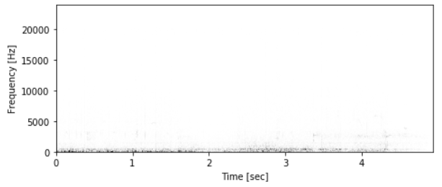
signal part
noise part

Slide 28
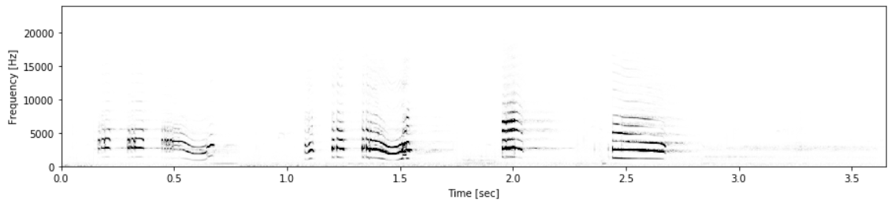
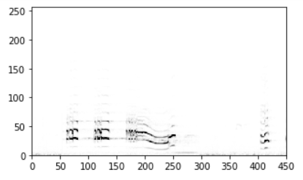
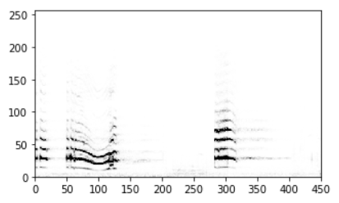
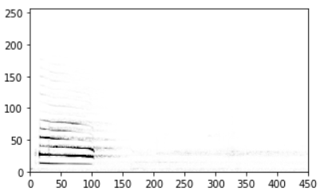
signal part

Slide 29
Sigmoid Layer
with 40 units

Slide 30
… | 0.63 | 0.01 | 0.03 | 0.94 | 0.02 | 0.00 | 0.01 | 0.23 | …

Slide 31
… | 0.63 | 0.01 | 0.03 | 0.94 | 0.02 | 0.00 | 0.01 | 0.23 | …

Slide 32
Results
model evaluation methods
accuracy & confusion matrix
Final model performance
error analysis

Slide 33
… | 0.63 | 0.01 | 0.03 | 0.94 | 0.02 | 0.00 | 0.01 | 0.23 | …

Slide 34
… | 0.63 | 0.01 | 0.03 | 0.94 | 0.02 | 0.00 | 0.01 | 0.23 | …
69%

Slide 35
… | 0.63 | 0.01 | 0.03 | 0.94 | 0.02 | 0.00 | 0.01 | 0.23 | …

Slide 36
… | 0.63 | 0.01 | 0.03 | 0.94 | 0.02 | 0.00 | 0.01 | 0.23 | …
82%

Slide 37
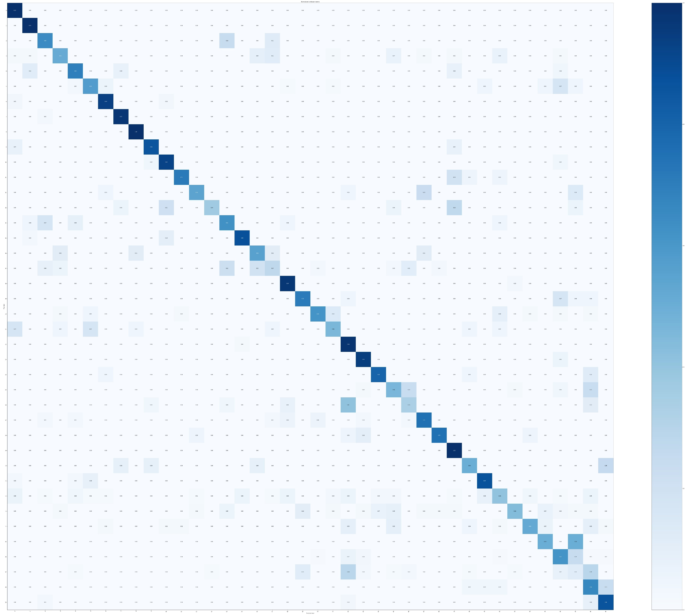
Results Error analysis
some common mistake
นกกระรางหัวขวาน, นกโพระดกธรรมดา → นกตีทอง
นกกระจิ๊ดเขียวคล้ำ, นกสีชมพูสวน → นกจับแมลงสีน้ำตาล
นกกินปลีอกเหลือง ↔ นกกินปลีดำม่วง
นกกระจอกบ้าน ↔ นกกระจอกใหญ่

Slide 38
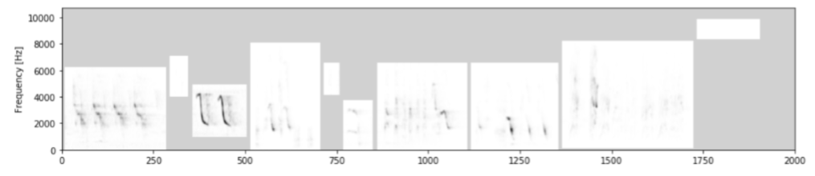
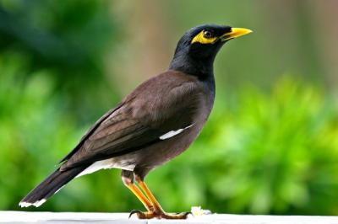
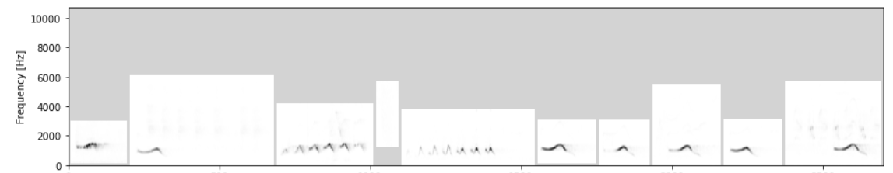
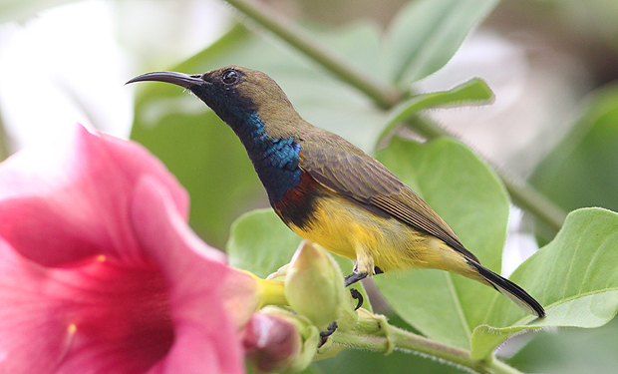
Results Error analysis
the low-performance class e.g. นกเอี้ยงสาริกา, นกกินปลีอกเหลือง

Slide 39
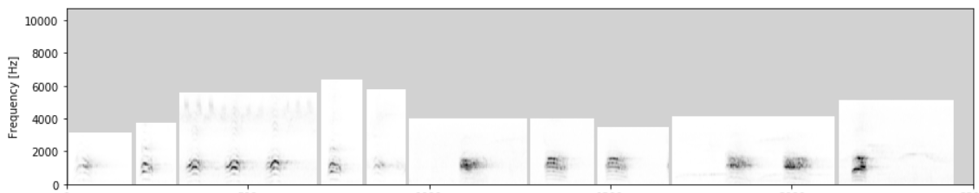
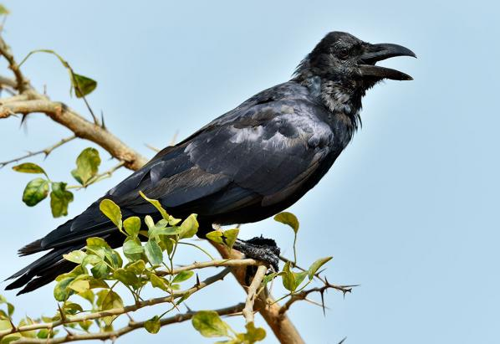
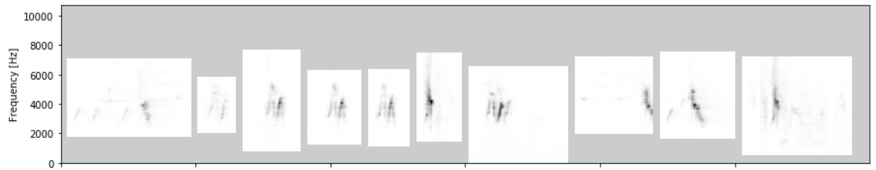

Results Error analysis
the high-performance class e.g. อีกา, นกกาเหว่า

Slide 40
Results Error analysis
Multi-label classification with random forest
feature generation take long time and not scalable
Multi-label classification with CNN
sensitive to class imbalance
→ only 8/80 class after 1000 epoch (acc. 24%)
longer time training

Slide 41







Discussion Limitations
restricted species due to conservation concerns
microphone quality & noise handling

Slide 42
Deployment & Demo
deployment diagram
deployment tools
Sample UI
live demo

Slide 43

Deployment Diagram

Slide 44



Deployment Sample UI

Slide 45
Demo
https://www.youtube.com/watch?v=vwPgfybdAHY นกอีวาบตั๊กแตน
https://www.youtube.com/watch?v=ZAsUX0lN6n4 อีกา
https://www.youtube.com/watch?v=Hfu6b29FhtA นกตีทอง
https://www.youtube.com/watch?v=UoWQGzJUXJ4 นกเขาใหญ่
https://www.youtube.com/watch?v=pM5ll1VLceo นกเขาชวา
https://www.youtube.com/watch?v=Qpjz2oE_Awg นกกระจิ๊ดธรรมดา
https://www.youtube.com/watch?v=9BMb4NseG4A นกเอี้ยงสาริกา
https://www.youtube.com/watch?v=qsBtyLAIx_w นกกินปลีอกเหลือง

Slide 46
Q&A

